Slide 1

AI-Systems Prediction Serving
Joseph E. Gonzalez
Co-director of the RISE Lab jegonzal@cs.berkeley.edu

Slide 2
Machine Learning Lifecycle
Inference

Slide 3
Inference
Goal: make predictions in ~10ms under bursty load
Complicated by Deep Neural Networks ➔ New ML Algorithms and Systems

Slide 4
why is challenging?
Inference
Need to render low latency (< 10ms) predictions for complex
Models
Queries
Features
SELECT * FROM
users JOIN items, click_logs, pages WHERE …
Top K
under heavy load with system failures.

Slide 5
Basic Linear Models (Often High Dimensional)
Common for click prediction and text filter models (spam)
Query x encoded in sparse Bag-of-Words:
x = “The quick brown” = {(”brown”, 1), (”the”, 1), (“quick”, 1)}
Rendering a prediction:
θ is a large vector of weights for each possible word
or word combination (n-gram models) …
Optimizations?

Slide 6
Support low-latency, high-throughput serving workloads
Models getting more complex
10s of GFLOPs [1]
Deployed on critical path
Maintain SLOs under heavy load
Using specialized hardware for predictions
[1] Deep Residual Learning for Image Recognition. He et al. CVPR 2015.
Notes:
FLOPs, numbers for models,

Slide 7
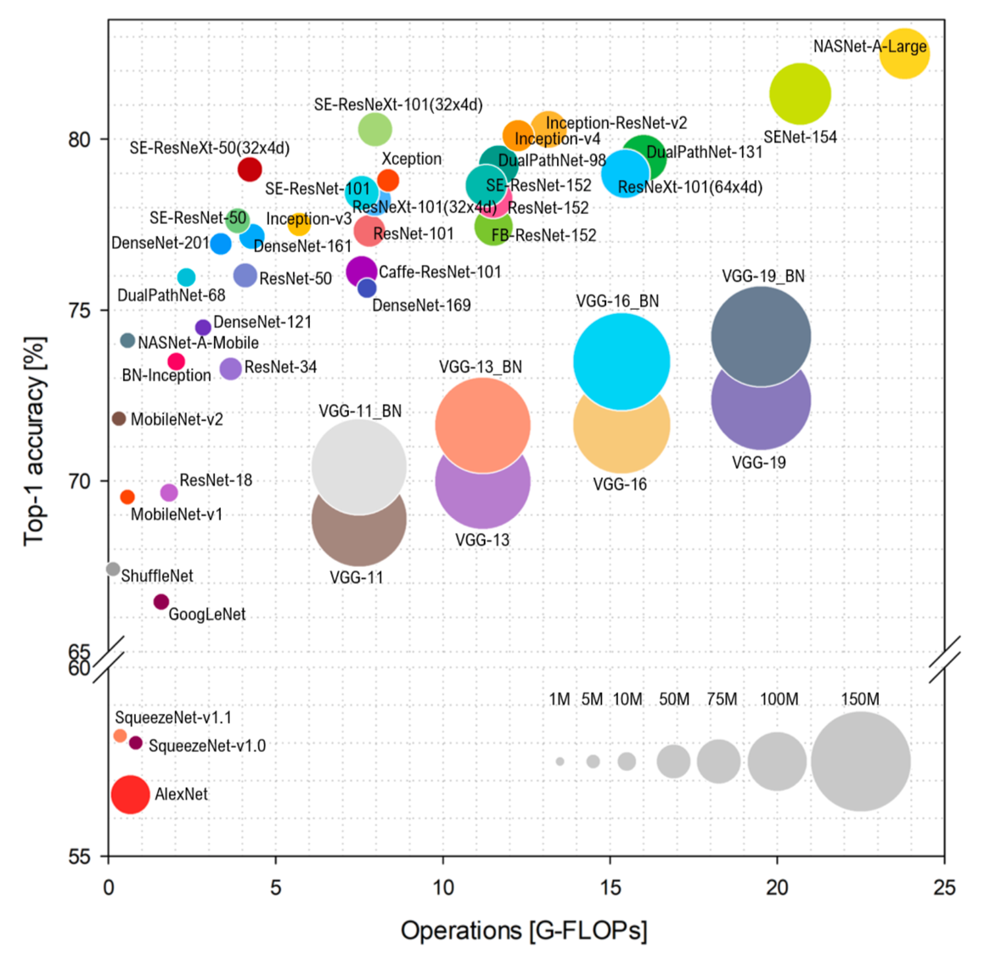
Benchmark Analysis of Representative Deep Neural Network Architectures
Batch Size
TitanXP

Slide 8
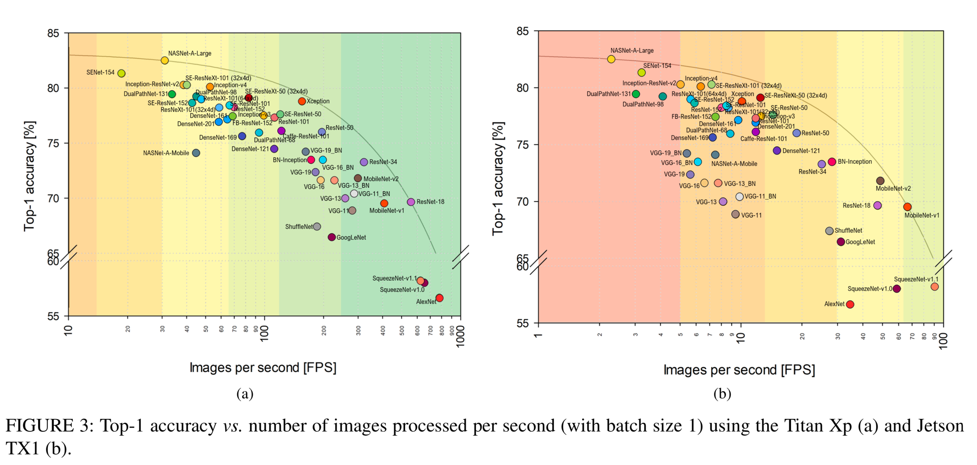
Benchmark Analysis of Representative Deep Neural Network Architectures
TitanXP
Mobile (Jetson TX1)

Slide 9
BERT-Large on a V100 (~$10K)
Results included Mixed precision optimizations!
Numbers obtained from: https://developer.nvidia.com/deep-learning-performance-training-inference

Slide 10
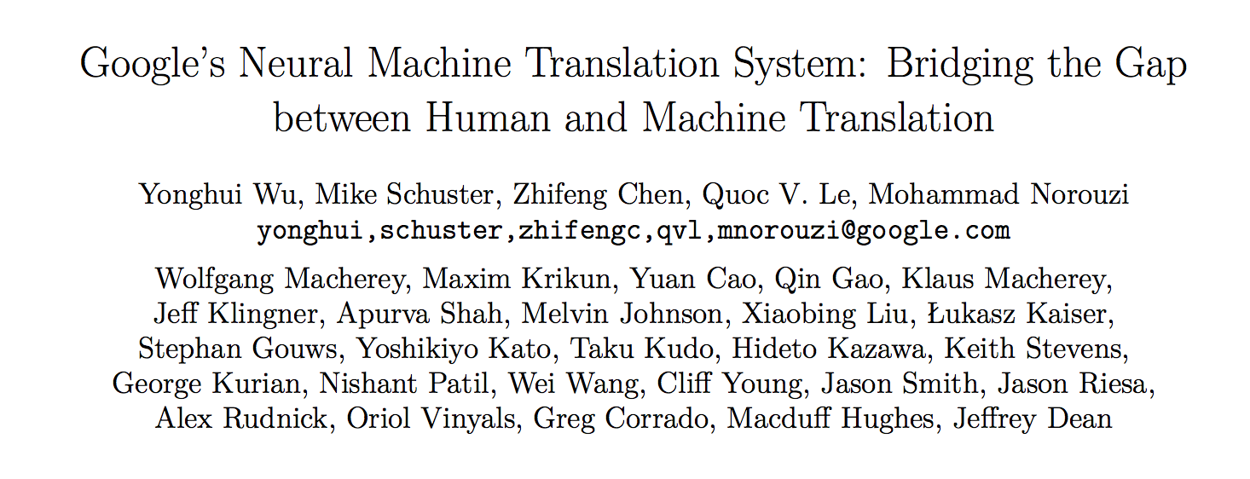
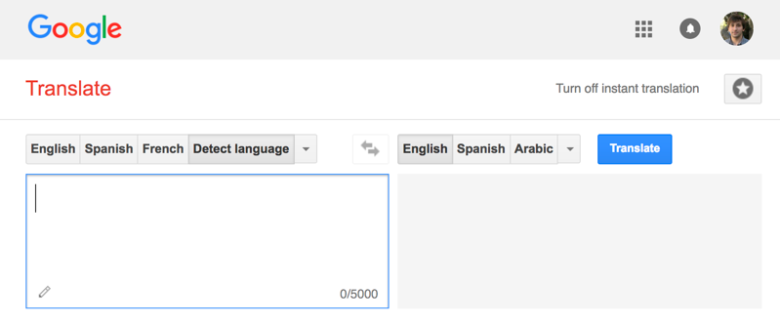
Google Translate
Serving
“If each of the world’s Android phones used the new Google voice search for just three minutes a day, these engineers realized, the company would need twice as many data centers.” – Wired
140 billion words a day¹
Designed New Hardware!
Tensor Processing Unit (TPU)
82,000 GPUs running 24/7
[1] https://www.nytimes.com/2016/12/14/magazine/the-great-ai-awakening.html
Notes:
Model scoring that drove Google to develop new hardware, not training
Mention Paul Barham’s talk

Slide 11
Other Challenges?
Bursty load →
overprovision resources →
expensive
TPU reports 28% utilization of vector units in production
Solutions
statistical multiplexing → difficult → why?
could try to predict arrival process → difficult (impossible?)!
Versioning and testing models
Prediction pipelines → more on this soon

Slide 12
Need Robust Predictions
Often want to quantify prediction accuracy
Use class conditional entropy?
Other techniques for modeling prediction uncertainty
Bayesian Inference
Need to maintain more statistics about each parameter
Often requires matrix inversion, sampling, or numeric integration
Bagging
Multiple copies of the same model trained on different subsets of data
Linearly increases complexity
Often robust predictions ➔ additional computation

Slide 13
Query
Inference
Decision
Big Model
Application
Two Approaches
Offline: Pre-Materialize Predictions
Online: Compute Predictions on the fly

Slide 14
Pre-materialized Predictions

Slide 15
Pre-materialized Predictions
Batch Training Framework
All Possible
Queries

Slide 16
Pre-materialized Predictions
Data Management System
Batch Training Framework
(Scoring)
All Possible
Queries

Slide 17
Pre-materialized Predictions
Data Management System
Batch Training Framework
(Scoring)
All Possible
Queries
Standard Data Eng. Tools

Slide 18
Serving Pre-materialized Predictions
Data Management System
Query
Batch Training Framework
(Scoring)
Decision
All Possible
Queries
Application
Low-Latency Serving
Standard Data Eng. Tools

Slide 19
Serving Pre-materialized Predictions
Data Management System
Advantages:
Leverage existing data serving and model training infrastructure
Batch processing improves hardware perf.
Indexing support for complex queries
Find all Pr(“cute”) dresses where price < $20
More predictable performance
Query
Batch Training Framework
(Scoring)
Decision
All Possible
Queries
Application
Low-Latency Serving

Slide 20
Serving Pre-materialized Predictions
Data Management System
Problems:
Requires full set of queries ahead of time
Small and bounded input domain
Requires substantial computation and space
Example: scoring all content for all customers!
Costly update → rescore everything!
Query
Batch Training Framework
(Scoring)
Decision
All Possible
Queries
Application
Low-Latency Serving

Slide 21
Query
Inference
Decision
Big Model
Application
Two Approaches
Offline: Pre-Materialize Predictions
Online: Compute Predictions on the fly

Slide 22
Query
Inference
Decision
Big Model
Application
Two Approaches
Offline: Pre-Materialize Predictions
Online: Compute Predictions on the fly

Slide 23
Prediction Services
Specialized systems which render predictions at query time.

Slide 24
Architecture of a Prediction Service
Edge
Cloud
Application Services
Data
Services
Client
Client
Client
Client
2
3
Client
1
4
Client
Prediction
Service
Load Balancer
12
Cache
Prediction
Service
9
5
Prediction
Service
Cache
11
8
Prediction
Service
10
Prediction
Service
6
Feedback
7

Slide 25
Architecture of a Prediction Service
Simple Prediction Service Design
Strengths
Leverages existing technologies
Easy to setup
Limitations
Need to address common issues
batching, monitoring, etc…
Limited isolation between models
Missed opportunity for common abstraction
Prediction
Service
Use existing web technologies.

Slide 26










Two Approaches to Prediction Service Design
VELOX
Clipper
Caffe
VW
Create

Slide 27
Addressing Feedback by Learning at Different Speeds
VELOX

Slide 28
Learning
Inference
Big
Data
Query
Training
Decision
Application
Feedback

Slide 29
Learning
Inference
Slow Changing
Model
Fast Changing Model
Big
Data
Query
Feedback
Training
Fast
Decision
Application
Feedback
Slow

Slide 30
Hybrid Offline + Online Learning
Update feature functions offline using batch solvers
Leverage high-throughput systems (Tensor Flow)
Exploit slow change in population statistics
Update the user weights online:
Simple to train + more robust model
Address rapidly changing user statistics

Slide 31
Common modeling structure
Matrix Factorization
Deep Learning
Ensemble
Methods
Items
Users
Ratings
Input

Slide 32
Velox Online Learning for Recommendations (20-News Groups)
Partial Updates: 0.4 ms
Retraining: 7.1 seconds
>4 orders-of-magnitude faster adaptation
Error
Partial Updates
Full Updates
Examples

Slide 33


Fast Changing Model
Learning
per user
Inference
Slow Changing
Model
Big
Data
Query
Feedback
Training
Fast
Decision
Application
Feedback
Slow

Slide 34
Learning
Fast Changing Model
Inference
Slow Changing
Model
per user
Big
Data
Query
Training
Feedback
Decision
Fast
Velox
Application
Feedback
Slow

Slide 35

VELOX Architecture
Fraud Detection
Content
Rec.
Keystone ML
Velox
MLLib
Spark
Single JVM Instance

Slide 36
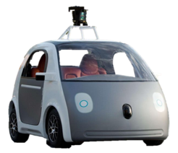






VELOX Architecture
Fraud Detection
Content
Rec.
Personal
Asst.
Robotic
Control
Machine
Translation
Keystone ML
Velox
VW
MLLib
Spark
Single JVM Instance
Create
Caffe

Slide 37

VELOX as a Middle Layer Arch?
Fraud Detection
Content
Rec.
Personal
Asst.
Robotic
Control
Machine
Translation
Generalize ?
Velox
VW
Create
Keystone ML
Spark
MLLib
Caffe

Slide 38
Clipper Generalizes Velox Across ML Frameworks
Fraud Detection
Content
Rec.
Personal
Asst.
Robotic
Control
Machine
Translation
Clipper
VW
Create
Caffe

Slide 39
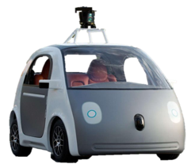

Middle layer for prediction serving.
Common Abstraction
System
Optimizations
VW
Create
Caffe
39

Slide 40


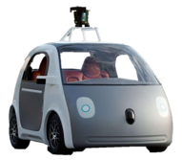
Clipper Decouples Applications and Models
Applications
Predict
RPC/REST Interface
Feedback
Clipper
RPC
RPC
RPC
RPC
Model Container (MC)
MC
MC
MC
Caffe
VW
Create

Slide 41




Clipper Architecture
Applications
Predict
RPC/REST Interface
Observe
Clipper
Improve accuracy through bandit methods and ensembles, online learning, and personalization
Model Selection Layer
Model Abstraction Layer
Provide a common interface to models
while bounding latency and maximizing throughput.
RPC
RPC
RPC
RPC
Model Container (MC)
MC
MC
MC
Caffe
Notes:
because model-abstraction layer lets you plug in many models, model selection layer chooses between them
introduce learning in selection layer later

Slide 42
Clipper Architecture
Applications
Predict
RPC/REST Interface
Observe
Clipper
Model Selection Layer
Selection Policy
Model Abstraction Layer
Caching
Adaptive Batching
RPC
RPC
RPC
RPC
Model Container (MC)
MC
MC
MC
Caffe

Slide 43


Applications
Predict
RPC/REST Interface
Observe
Clipper
Correction Layer
Correction Policy
Model Abstraction Layer
Approximate Caching
Adaptive Batching
RPC
RPC
RPC
RPC
Model Wrapper (MW)
MW
MW
MW
Caffe
Provide a common interface to models while bounding latency and maximizing throughput.

Slide 44
Clipper
Correction Layer
Correction Policy
Model Abstraction Layer
Caching
Adaptive Batching
RPC
RPC
RPC
RPC
Model Container (MC)
MC
MC
MC
Caffe
Common Interface → Simplifies Deployment:
Evaluate models using original code & systems
Notes:
make containers green

Slide 45
Container-based Model Deployment
Implement Model API:
class ModelContainer:
def __init__(model_data)
def predict_batch(inputs)
Notes:
Black-box abstraction

Slide 46
Container-based Model Deployment
Implement Model API:
class ModelContainer:
def __init__(model_data)
def predict_batch(inputs)
Implemented in many languages
Python
Java
C/C++
Notes:
Data scientist doesn’t have to learn any new skills

Slide 47
Container-based Model Deployment
Model implementation packaged in container
Model Container (MC)
class ModelContainer:
def __init__(model_data)
def predict_batch(inputs)
VW
Create

Slide 48
Container-based Model Deployment
Clipper
RPC
RPC
RPC
RPC
Model Container (MC)
MC
MC
MC
Caffe
VW
Create
Notes:
From the frontend dev perspective Clipper

Slide 49
Clipper
Correction Layer
Correction Policy
Model Abstraction Layer
Caching
Adaptive Batching
RPC
RPC
RPC
RPC
Model Container (MC)
MC
MC
MC
Caffe
Common Interface → Simplifies Deployment:
Evaluate models using original code & systems
Models run in separate processes as Docker containers
Resource isolation

Slide 50
Clipper
Correction Layer
Correction Policy
Model Abstraction Layer
Caching
Adaptive Batching
RPC
RPC
RPC
RPC
RPC
RPC
Model Container (MC)
MC
MC
MC
MC
MC
Caffe
Common Interface → Simplifies Deployment:
Evaluate models using original code & systems
Models run in separate processes as Docker containers
Resource isolation
Scale-out
Problem: frameworks optimized for batch processing not latency

Slide 51
Batching to Improve Throughput
Why batching helps:
Optimal batch depends on:
hardware configuration
model and framework
system load
A single
page load may generate
many queries
Hardware
Acceleration
Helps amortize
system overhead
Notes:
Make clearer that batching navigates tradeoff between throughput and latency

Slide 52
Batching to Improve Throughput
Adaptive
Why batching helps:
Optimal batch depends on:
hardware configuration
model and framework
system load
A single
page load may generate
many queries
Clipper Solution:
Adaptively tradeoff latency and throughput…
Inc. batch size until the latency objective is exceeded (Additive Increase)
If latency exceeds SLO cut batch size by a fraction (Multiplicative Decrease)
Hardware
Acceleration
Helps amortize
system overhead

Slide 53
Tensor Flow Conv. Net (GPU)
Better
Throughput (Queries Per Second)
Batch Size
Notes:
Two plots, thorughput on top, latency on bottom

Slide 54
Tensor Flow Conv. Net (GPU)
Better
Throughput (Queries Per Second)
Latency (ms)
Better
Batch Size
Notes:
Two plots, thorughput on top, latency on bottom

Slide 55
Tensor Flow Conv. Net (GPU)
Better
Throughput (Queries Per Second)
Optimal Batch Size
Latency (ms)
Better
Batch Size
Notes:
Two plots, thorughput on top, latency on bottom

Slide 56
Better
Throughput
(QPS)

Slide 57
Better
Throughput
(QPS)

Slide 58
Better
Throughput
(QPS)
P99 Latency
(ms)
20 ms is
Fast Enough
Better

Slide 59
Throughput
(QPS)
P99 Latency
(ms)
Batch Size
Notes:
put batching on bottom

Slide 60
Overhead of decoupled architecture
Applications
Predict
RPC/REST Interface
Feedback
Clipper
RPC
RPC
RPC
RPC
MC
MC
MC
MC
Caffe

Slide 61




Overhead of decoupled architecture
Applications
Applications
Predict
RPC Interface
Predict
RPC/REST Interface
Feedback
TensorFlow-Serving
Clipper
RPC
RPC
RPC
RPC
MC
MC
MC
MC
Caffe
Notes:
adopts a more monolithic architecture with both the serving and model-evaluation code in a single process

Slide 62




Overhead of decoupled architecture
Applications
Applications
Predict
RPC/REST Interface
Feedback
Predict
RPC Interface
Clipper
TensorFlow-Serving
RPC
RPC
RPC
RPC
Model Container
MC
MC
MC
Caffe
Notes:
adopts a more monolithic architecture with both the serving and model-evaluation code in a single process

Slide 63
Overhead of decoupled architecture
Model: AlexNet trained on CIFAR-10
Better
P99 Latency
(ms)
Throughput
(QPS)
Better
TensorFlow Serving
Clipper
TensorFlow Serving
Clipper
Notes:
just cifar, cut python

Slide 64
Clipper Architecture
Applications
Predict
RPC/REST Interface
Observe
Clipper
Improve accuracy through bandit methods and ensembles, online learning, and personalization
Model Selection Layer
Model Abstraction Layer
Provide a common interface to models
while bounding latency and maximizing throughput.
RPC
RPC
RPC
RPC
Model Container (MC)
MC
MC
MC
Caffe
Notes:
because model-abstraction layer lets you plug in many models, model selection layer chooses between them
introduce learning in selection layer later

Slide 65
Applications
Predict
RPC/REST Interface
Observe
Clipper
Improve accuracy through bandit methods and ensembles, online learning, and personalization
Model Selection Layer
Version 1
Periodic retraining
Version 2
Version 3
Experiment with new models and frameworks
Caffe
Notes:
By combining predictions from multiple models we can improve application accuracy and quantify confidence in predictions

Slide 66
Selection Policy: Estimate confidence
Version 2
Version 3
“CAT”
“CAT”
CONFIDENT
“CAT”
Policy
“CAT”
“CAT”
Caffe

Slide 67
Selection Policy: Estimate confidence
“CAT”
“CAT”
UNSURE
“MAN”
Policy
“CAT”
Caffe
“SPACE”
Notes:
“Not a cat picture”

Slide 68
Selection Policy: Estimate confidence
Better
Notes:
put best model accuracy back in

Slide 69
Selection Policy: Estimate confidence
Better
width is percentage of query workloads

Slide 70
Selection policies supported by Clipper
Applications
Predict
RPC/REST Interface
Observe
Clipper
Model Selection Layer
Selection Policy
Exploit multiple models to estimate confidence
Use multi-armed bandit algorithms to learn optimal model-selection online
Online personalization across ML frameworks

Slide 71
Online: Compute Predictions at Query Time
Examples
Speech recognition, image tagging
Ad-targeting based on search terms, available ads, user features
Advantages
Compute only necessary queries
Enables models to be changed rapidly and bandit exploration
Queries do not need to be from small ground set
Disadvantages
Increases complexity and computation overhead of serving system
Requires low and predictable latency from models

Slide 72
Prediction Pipelines

Slide 73
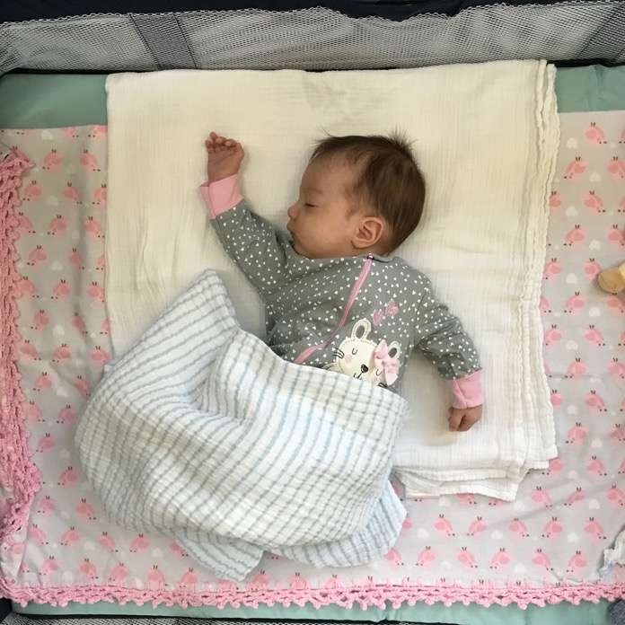
Query Image
Example
This is my daughter!

Slide 74

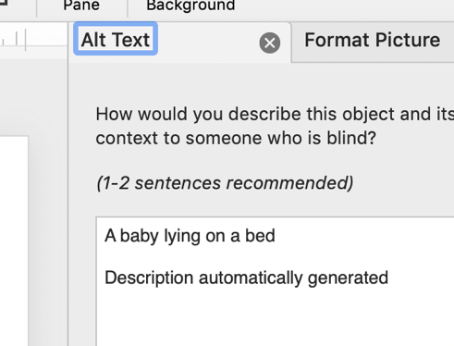
Query Image
Machine Learning
Model
Prediction
“A baby lying on a bed”
This caption was generated automatically in the cloud by Microsoft PowerPoint

Slide 75


More realistic → Prediction Pipeline
Machine Learning
Model
Ensemble
Query Image
Prediction
Resizing
“A baby lying on a bed”
“Voting”
Prediction
“Compositing”
Background
Prediction
Segmentation
This caption was generated automatically in the cloud by Microsoft PowerPoint!

Slide 76

More realistic → Prediction Pipeline
Machine Learning
Model
Ensemble
Query Image
Prediction
Resizing
“A baby lying on a bed”
“Voting”
Prediction
“Compositing”
Background
Prediction
Segmentation
How do we provision resources for these pipelines?
Latency vs. Throughput vs. Cost
This caption was generated automatically in the cloud by Microsoft PowerPoint!

Slide 77

Prediction Serving in the Cloud
More realistic → Prediction Pipeline
How do we provision resources for these pipelines?
Latency vs. Throughput vs. Cost
CPU
GPU
CPU
GPU
CPU
CPU
CPU
GPU
CPU
GPU
“Voting”
Two readings this week will address this problem.
Pretzel
InferLine
CPU
CPU
CPU
CPU
Resizing
CPU
GPU
GPU
CPU
CPU
CPU
“Compositing”
CPU
GPU
GPU
CPU
CPU
Segmentation
CPU
CPU
CPU
Background
Prediction
This caption was generated automatically in the cloud by Microsoft PowerPoint!

Slide 78
Cloud -- Edge

Slide 79

Example
Home video security systems

Slide 80

Technology
AC Powered Lamp
Commodity ARM proc.
720HD Video
Microphone & Speaker
Infrared Motion Sensors
Goals:
Detect, identify, and record people
Notify homeowner and open channel of comm.

Slide 81
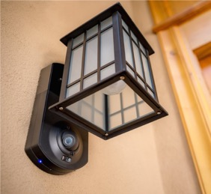
How does work?
Fast onboard pixel-level filter identifies suspicious change
Person1
Key frames are sent to EC2 for further processing
More sophisticated processing to reduce false positives (costly GPU time)
Person1

Slide 82
technology challenges
Splitting classification across device and cloud.
Shared learning to identify common patterns
e.g., traffic in urban environments
More efficient prediction rendering on cloud + edge
Running full CV pipeline on all images is very costly
Desired Capabilities
Event characterization: “Package delivery at 1:33 PM”
Automatic user interaction: “I would be happy to digitally sign for the package …”
Person1

Slide 83
Reading This Week

Slide 84
Reading for the Week
Pretzel: Opening the Black Box of Machine Learning Prediction Serving Systems (OSDI’18)
Optimizing prediction serving pipeline using compiler and database system techniques
InferLine: ML Inference Pipeline Composition Framework (pre-print)
Optimizing prediction serving pipeline configurations for deep learning on heterogenous hardware
Focus: Querying Large Video Datasets with Low Latency and Low Cost (OSDI’18)
Enabling real-time queries on video data with offline pre-processing

Slide 85
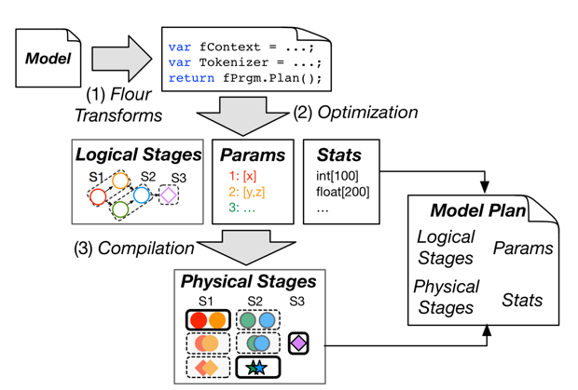
Pretzel: Opening the Black Box of Machine Learning Prediction Serving Systems
Addresses a range of practical issues:
Dealing with infrequently used models
Need to “page-out” infrequently used models → Cold starts
Need to pack many models in same machine
Sharing model stages across prediction pipelines
Eliminate redundant computation and memory requirements
Pushing computation (reuse) through feature concatenation
Generating efficient binary executables from high-level DSLs
Setting: Focused on non-deep learning pipelines
CPU Intensive
ML.Net Infrastructure and production workloads
Big Idea: Leverage visibility into pipeline achieved by high-level pipeline DSL to optimize execution across pipelines and stages within a pipeline
What to look for in reading
Motivations driven by real-world workload profiling
Combination of offline and online optimization
Decomposition of problem into logical and physical plans and runtime scheduling

Slide 86
Pretzel: Opening the Black Box of Machine Learning Prediction Serving Systems
Addresses a range of practical issues:
Dealing with infrequently used models
Need to “page-out” infrequently used models → Cold starts
Need to pack many models in same machine
Sharing model stages across prediction pipelines
Eliminate redundant computation and memory requirements
Pushing computation (reuse) through feature concatenation
Generating efficient binary executables from high-level DSLs
Setting: Focused on non-deep learning pipelines
CPU Intensive
ML.Net Infrastructure and production workloads
Big Idea: Leverage visibility into pipeline achieved by high-level pipeline DSL to optimize execution across pipelines and stages within a pipeline
What to look for in reading
Motivations driven by real-world workload profiling
Combination of offline and online optimization
Decomposition of problem into logical and physical plans and runtime scheduling

Slide 87
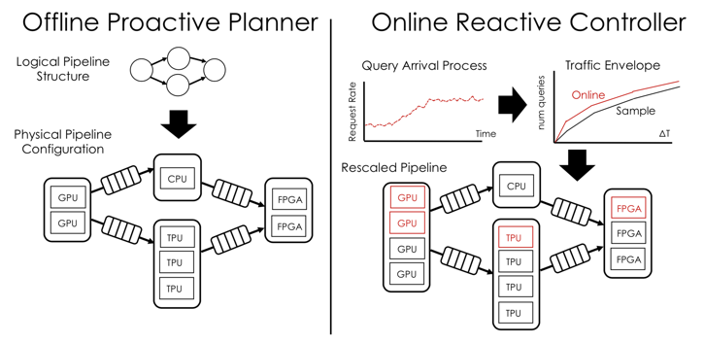
InferLine: Prediction Pipeline Provisioning and Management for Tight Latency Objectives
Context: This is a pre-print paper from my group
Submitted OSDI’18 and SOSP’19 → rejected ☹
Issues with presentation and contributions
How can we review a professor’s paper?
Your honest feedback is very helpful!
Why choose this paper?
Discusses a range of challenges in black-box pipeline management
Presents interesting configuration space
We need feedback! (It is ok to be negative.)

Slide 88
InferLine: Prediction Pipeline Provisioning and Management for Tight Latency Objectives
Big Idea: Optimally configure per-model parameters in a prediction pipeline to achieve probabilistically bounded tail latency at minimal cost.

Slide 89
Technical Ideas in the InferLine Project
Arrival Process Characterization
Discrete Event Continuous Time Simulator
+ Network
Calculus
Individual Model Profiles
Proactive and Reactive Optimizer
Initial Config
Cost Minimizing Actions
invalid
Bang Bang &
PID Reactive Controller
Optimal Config

Slide 90
InferLine: Prediction Pipeline Provisioning and Management for Tight Latency Objectives
Technical Ideas (summary)
Individual model performance profiles + discrete event simulation → reason about end-to-end latency in the presence of complex queuing behavior
Simple greedy search heuristic to configure for each model:
Hardware type, number of copies, and batching parameters
Online re-provisioning using network calculus to optimally resize
What to look for:
Too many ideas …. not enough contribution?
Clarity of presentation

Slide 91
Focus: Querying Large Video Datasets with Low Latency and Low Cost
Context: builds on a line of earlier work
Live Video Analytics at Scale with Approximation and Delay-Tolerance (NSDI’17)
Chameleon: Scalable Adaptation of Video Analytics (SIGCOMM’18)
Big Ideas in the Line of Work:
Trade-off accuracy and latency in video processing tasks
Schedule resources according to acc. and latency requirements
Different “Serving Model”:
Large queries on historical or video streams:
Find all the times where a car and a bike are in a frame.

Slide 92
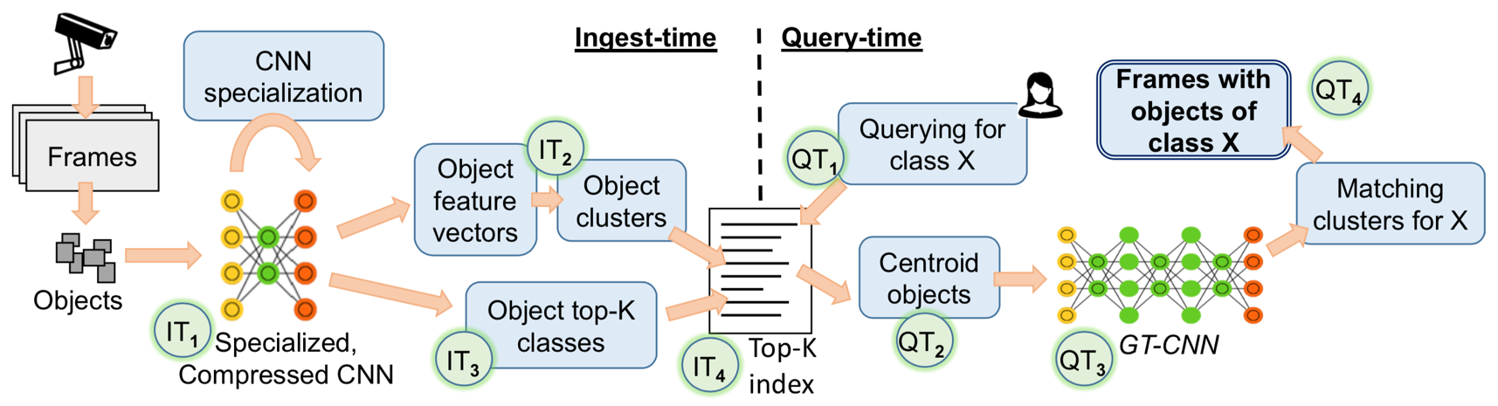
Focus: Querying Large Video Datasets with Low Latency and Low Cost
Big Idea(s)

Slide 93
Focus: Querying Large Video Datasets with Low Latency and Low Cost
What to look for:
Framing of relationships between object detection models and image classification
Faster R-CNN
Yolo (You Only Look Once)

Slide 94
Focus: Querying Large Video Datasets with Low Latency and Low Cost
What to look for:
Framing of relationships between object detection models and image classification
R-CNN
https://medium.com/@jonathan_hui/what-do-we-learn-from-region-based-object-detectors-faster-r-cnn-r-fcn-fpn-7e354377a7c9

Slide 95
Focus: Querying Large Video Datasets with Low Latency and Low Cost
What to look for:
Framing of relationships between object detection models and image classification
R-CNN
Identify regions of interest and run feature network on each.
Fast R-CNN
Reuse feature outputs for all externally proposed regions.
https://medium.com/@jonathan_hui/what-do-we-learn-from-region-based-object-detectors-faster-r-cnn-r-fcn-fpn-7e354377a7c9

Slide 96
Focus: Querying Large Video Datasets with Low Latency and Low Cost
What to look for:
Framing of relationships between object detection models and image classification
Identify regions of interest and run feature network on each.
Reuse feature outputs for all externally proposed regions.
R-CNN
Fast R-CNN
Use region proposal network
Faster R-CNN
https://medium.com/@jonathan_hui/what-do-we-learn-from-region-based-object-detectors-faster-r-cnn-r-fcn-fpn-7e354377a7c9

Slide 97
Focus: Querying Large Video Datasets with Low Latency and Low Cost
What to look for:
Framing of relationships between object detection models and image classification
Identify regions of interest and run feature network on each.
Reuse feature outputs for all externally proposed regions.
R-CNN
Fast R-CNN
Use region proposal network
Faster R-CNN
Yolo (you only look once)
https://medium.com/@jonathan_hui/what-do-we-learn-from-region-based-object-detectors-faster-r-cnn-r-fcn-fpn-7e354377a7c9

Slide 98
Focus: Querying Large Video Datasets with Low Latency and Low Cost
What to look for:
Framing of relationships between object detection models and image classification
Do they leverage the structure of object detection models?
Split between ingest and query time computation
Tradeoff between accuracy and latency → how is it evaluated?
Presentation → many optimizations explored, do they fit together?

Slide 99
Done!

Slide 100
Cascaded Predictions

Slide 101



IDK
Prediction
Cascades
Simple models for simple tasks
Xin
Wang
Yika
Luo
Zi-Yi
Duo
Fisher
Yu
Simple Model
I don’t
Know
Accurate Model
Query
Fast
Slow
Prediction
Prediction
Learn to combine fast (inaccurate) models with slow (accurate) models to maximize accuracy while reducing computational costs.

Slide 102
Simple Model
I don’t
Know
Accurate Model
Query
Fast
Slow
Prediction
Prediction
SkipNet: dynamic execution within a model
Query
Prediction
Conv
Conv
Conv
Conv
Gate
Conv
Conv
Gate
Conv
FC

Slide 103
Simple Model
I don’t
Know
Accurate Model
Query
Fast
Slow
Prediction
Prediction
SkipNet: dynamic execution within a model
Query
Prediction
Conv
Conv
Conv
Conv
Gate
Conv
Conv
Gate
Conv
FC
Skip Blocks

Slide 104
Simple Model
I don’t
Know
Accurate Model
Query
Fast
Slow
Prediction
Prediction
SkipNet: dynamic execution within a model
Query
Prediction
Conv
Conv
Conv
Conv
Gate
Conv
Conv
Gate
Conv
FC
Skip Blocks
Combine reinforcement learning with supervised pre-training to learn a gating policy

Slide 105
SkipNet Performance
Easy Images Skip Many Layers
Hard Images
Skip Few Layers

Slide 106
Efficient Neural Networks

Slide 107
for fast and accurate inference
Dynamic Networks
IDK Cascades: Using the fastest model possible [UAI’18]
SkipNet: dynamic execution within a model [ECCV’18]
Skipped
Blocks
Query
Conv
Prediction
Conv
Conv
Conv
Gate
Conv
Conv
Gate
Conv
FC

Slide 108
for fast and accurate inference
Dynamic Networks
IDK Cascades: Using the fastest model possible [UAI’18]
Simple Model
I Don’t
Know
Accurate Model
Query
Fast
Slow
Prediction
Prediction
SkipNet: dynamic execution within a model [ECCV’18]
Skipped
Blocks
Query
Conv
Prediction
Conv
Conv
Conv
Gate
Conv
Conv
Gate
Conv
FC
Large Reductions in FLOPS
Skip more layers on clear images
Easy Images Skip Many Layers
Hard Images
Skip Few Layers

Slide 109


Task Aware Feature Embeddings [CVPR’19]
Feature
Network
FF Net
FF Net
FF Net
Baby
Task Aware
Meta-Learner
Params
x
Params
x
Params
x
More accurate and efficient than existing
dynamic pruning
networks
Emb.
Network
FC Layer
FC Layer
FC Layer

Slide 110
Task Aware Feature Embeddings [CVPR’19]
Dynamic Networks
Feature
Network
FF Net
FF Net
FF Net
Yes
Task Aware
Meta-Learner
Params
x
Params
x
Params
x
Task Description:
4 - 15% improvement on attribute-object tasks
“Smiling
Baby”
Emb.
Network
FC Layer
FC Layer
FC Layer

Slide 111
Leverage motion to improve the speed and accuracy of semantic segmentation
Optical Flow

Slide 112
Query
Simple Model
ResNet152
37% reduction in runtime @ no loss in accuracy

Slide 113
Simple Model
I don’t
Know
ResNet152
Query
Fast
Slow
Prediction
Prediction
Cascades within a Model
Query
Prediction
Conv
Conv
Conv
Conv
Gate
Conv
Conv
Gate
Conv
FC

Slide 114
Simple Model
I don’t
Know
Accurate Model
Query
Fast
Slow
Prediction
Prediction
Cascades within a Model
Query
Prediction
Conv
Conv
Conv
Conv
Gate
Conv
Conv
Gate
Conv
FC
Skip Blocks

Slide 115
Cascading reduces computational cost
Similar gains on larger models

Slide 116
Easy Images
Difficult Images
Skip More
Skip More
Skip Less
Skip Less
Number of Layers Skipped

Slide 117
Future Directions for Cascades
Using reinforcement learning techniques to reduce gating costs
Query triage during load spikes → forcing fractions of the network to go dark
Irregular execution →
complicates batching
Issues for parallel execution

